Slide 1
Instagram scraper tutoiral
Nick Chao 2019/12/2

Slide 2
Package---instagram-scraper
pip install instagram-scraper
GitHub: https://github.com/rarcega/instagram-scraper

Slide 3
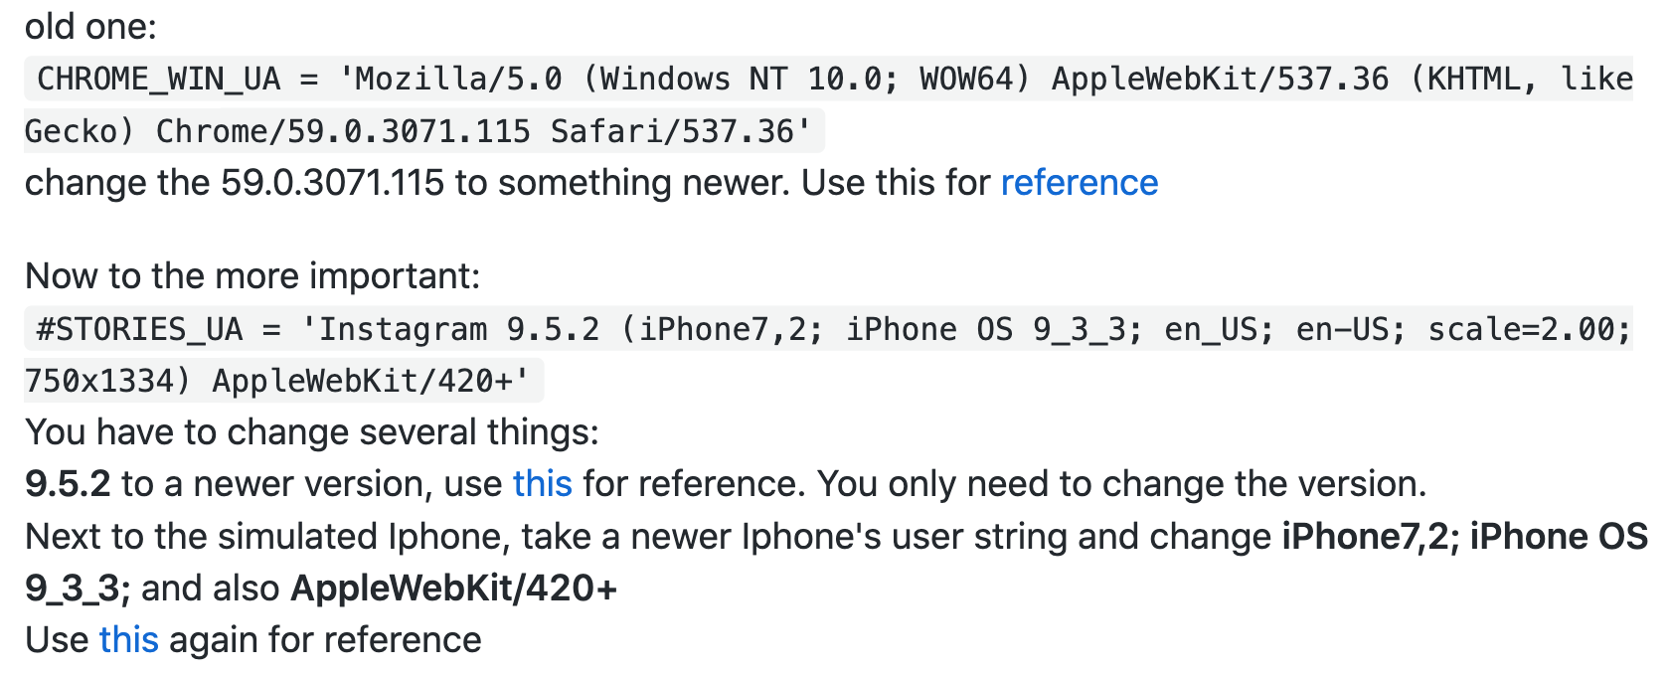
Before get started---Browser agent issue
Since the user-agents in the constants.py is outdated, we need to modify the following two arguments--- Solution for road blocked accounts #259

Slide 4
Command line
instagram-scraper -f <other_users_file.txt> -u <yourAccount> -p <yourPasswprt> -T{datetime} --media-metadata --profile-metadata
Arguments
-T{datetime}
Customize the file name format into Date and time of upload
--media-metadata
Saves the media metadata associated with the user's posts to <destination>/<username>.json. Can be combined with --media-types none to only fetch the metadata without downloading the media.
--profile-metadata
Saves the user profile metadata to <destination>/<username>.json.

